Slide 1

Orchestrating tomorrow’s supply chain today
Click this link to get:
The latest version of this deck
Other client ready and support materials
Executive reports
Webinars
Key contacts across IBM
Infusing the electronics supply chain with new potential
Matthieu Van Bilsen | Optional presenter’s title/credentials

Slide 2
Orchestrating tomorrow’s supply chain today
Infusing the electronics supply chain with new potential

Slide 3
In the next 18 to 36 months, the most advanced supply chain partners will…
Prelude
Be able to better support their organizations is the development, delivery and cost management of new business models
Embrace and apply data throughout their organizational processes
Enable increased traceability and provenance to predict problems earlier

Slide 4
First, some context…

Slide 5

Traditional supply chain software isn’t inherently intelligent
It’s programmed, so
it is designed with the intelligence available at a point in time

Slide 6
However, new cloud-based approaches surround supply chain software with AI, blockchain and advanced analytics to improve outcomes

Slide 7

However, many organizations are struggling to gain the experience they need in piloting these new tools and techniques
Notes:
Artificial Intelligence, Visualization and Augmented Reality can prove challenging, from building the business case to delivering new competencies and user education

Slide 8

But early adopters are working hard to enhance their supply chain with new forms of data and technology
Notes:
Starting with improving mobility and collaboration

Slide 9
Yet, electronics firms need to adapt swiftly: competitive threats, commoditization and new entrants are already present
51%
Competitors are using innovative tech or approaches to deliver a more compelling value proposition
27%
Product commoditization is eroding our margins
24%
New entrants are taking market share
Sampling: Global Electronics participants
Source: Q2.5: How is your enterprise's current business model being threatened? [Select all that apply]

Slide 10
And electronics firms recognize the pressing need for change…
Past 2 – 3 years
Next 2 – 3 years
53% |  | 48% | | | Modifying elements of our existing business model
26% |  | 44% | | | Launching a new business model within our existing industry
26% |  | 22% | | | Moving upstream or downstream within our current industry value chain
19% |  | 21% | | | Purchasing an existing business to acquire its business model
16% |  | 9% | | | Launching a new business model in an adjacent or unrelated industry
2% |  | 6% | | | Return to core and/or divest unprofitable business
Sampling: Global Electronics participants
2.4.1 Change in enterprise's business model (past 2-3 yrs.) (MR all)(including EXCLUSIVE CHOICE) and Q2.4.2: Change in enterprise's business model (next 2-3 yrs.) (MR all)(INCLUDING EXCLUSIVE CHOICE) . Please note, some items contain a low respondent sample and may not be fully indicative, ]
Notes:
While 25 percent of respondents indicated their business model is currently successful, most electronics companies want to pursue new approaches
The critical activity has been modifying the existing business model. This is expected to remain at the top
However more than doubling in importance is a recognition for new business models within the industry.
Launching a new business model outside of industry triples from a very low base.

Slide 11
In the 2017 IBM IBV C-suite study, cluster analysis revealed three archetypes, and one is breaking ahead quickly
Reinventors
Reinventors differentiate themselves in seven areas
Customer experience focus
Data and insights to innovate products and services
Deploying digital technologies
Latest technologies to transform interactions and transactions
Competitive strategy
Disrupt by changing the rules of the game
Data and analytics to inform business strategy
Organization agility
Rapid prototyping to test and refine strategy
Aligned IT and business strategy
Short feedback and adaptation cycles
29%
Practitioners
32%
Aspirationals
39%
Sampling: Global Electronics participants
Notes:
To better understand the forces at play, we applied cluster analysis to identify distinct segments of organizations among the more than 12,500 participants in this study. Three archetypes emerged, which we’ve named the Reinventors, the Practitioners and the Aspirationals. The organizations clustered in these archetypes are at different stages of Digital Reinvention™ and are eyeing the opportunities ahead from that vantage point.
Questions defining the cluster:
Customer experience focus. Using data and insights to innovate products and services. Q1.2.h – How effective is your enterprise at creating compelling customer experiences through the following actions? [Using data and insights to constantly innovate our products and services]
Deploying digital technologies. Using the latest technologies to transform interaction and transactions. Q1.2.g – How effective is your enterprise at creating compelling customer experiences through the following actions? [Deploying digital technologies to transform interaction and transactions]
Competitive strategy. Disrupt a new market or industry by completely changing the rules of the game. Q2.3.e – Which of the following best characterizes your enterprise’s current competitive strategy? [e. Disrupt]
Competitive strategy. Leverage data and analytics to inform business strategy. Q2.2.g – To what extent do you agree with the following statements concerning your business strategy? [We leverage data and analytics to inform our business strategy]
Organization agility. Rapid prototyping to test and refine strategy. Q2.2.c – To what extent do you agree with the following statements concerning your business strategy? [We use a rapid prototyping, ‘build as you design, modify as you go’ approach to test and refine elements of our strategy]
Organization agility. Aligned IT and business strategy. Q2.2.f – To what extent do you agree with the following statements concerning your business strategy? [Our IT strategy is closely aligned with our business strategy]
Organization agility. Short feedback and adaptation cycles. Q3.7.d – To what extent do you agree with the following statements about your enterprise? [We aim for short feedback and adaptation cycles throughout the planning, design and implementation stages of a project]

Slide 12
Reinventors outperform on revenue growth and profitability while leading in innovation
Financial performance – revenue growth, profitability and innovation
77%
72%
61%
50%
46%
46%
31%
33%
32%
High revenue growth
High profitability
Leading innovator
Reinventors
Practitioners
Aspirationals
Sampling: Electronics participants
Percentages represent the number of respondents who selected 4 or 5 on a 5-point scale. Source: P.1 How does the revenue growth (or budget growth) of your enterprise compare to that of your industry peers over the past 3 years? [Significantly outperform industry]; P.2 How does your enterprise’s profitability (or efficiency) compare to that of your peers over the past 3 years? [Significantly outperform industry]; P.3 What is the market perception of your enterprise’s innovation capability, relative to that of your industry peers? [Leading innovator]
Notes:
The Reinventors, making up 29 percent of the total, are the standouts. They report that they outperformed their peers in both revenue growth and profitability over the past three years, and led as well in innovation.

Slide 13
Business processes are better aligned to strategy among Reinventors
Our business processes are optimized to support our business strategy
Electronics Reinventors
Electronics Practitioners
Electronics Aspirationals
64%
44%
27%
Sampling: Electronics participants
Percentages represent the number of respondents who selected 4 or 5 on a 5-point scale. Source: Q2.2.e To what extent do you agree with the following statements concerning your business strategy? – Our business processes are optimized to support our business strategy
Notes:
Their organizations are exceptionally well aligned. They say that their IT strategy is in sync with their business strategy and they’ve optimized their business processes to support their strategic intentions.

Slide 14
Reinventors lead from a position of trust and actively solicit ideas from employees and empower their teams
We actively solicit from employees to develop new ideas and approaches
Our teams are empowered to decide on the best course of action
79% 55%
46%
74% 54%
33%
Reinventors Practitioners Aspirationals
Sampling: Electronics participants
Percentages represent the number of respondents who selected 4 or 5 on a 5-point scale. Source [left]: Q3.2.d To what extent do you agree with the following statements about the leadership across your enterprise? – Our leadership actively solicits input from employees to develop new ideas and approaches [To a large extent]. Source [right]: Q3.7.c To what extent do you agree with the following statements about your enterprise? - Our teams are empowered to decide on the best course of action [To a large extent]
Notes:
Reinventors lead from a position of trust: 79 percent actively solicit ideas from employees in order to develop new approaches, compared to 55 percent of Practitioners and 46 percent of Aspirationals. Seven in ten Reinventors empower their teams to decide the best course of action. These leaders aren’t afraid to let their teams see that their views evolve. Doing so models a new way forward.

Slide 15
Reinventors excel at capitalizing on data
Organization agility
We use rapid prototyping to test and refine our strategy
Customer insights
80%
74%
69%
76% 42%
26%
58%
59%
50%
37%
35%
28%
Reinventors Practitioners Aspirationals
Use data to identify undefined and unmet customer needs
Use insights to constantly innovate products and services*
Very effective at acting upon insights to meet customer expectations
Sampling: Electronics participants
* One of seven variables that defines the cluster for Reinventors, Practitioners and Aspirationals. Percentages represent the number of respondents who selected 4 or 5 on a 5-point scale. Source [left]: Q2.2.c To what extent do you agree with the following statements concerning your business strategy? – We use a rapid prototyping, ‘build as you design, modify as you go’ approach to test and refine elements of our strategy. Source [right]: Q1.2 [a,h,c] How effective is your enterprise at creating compelling customer experiences through the following actions? – Using data to identify undefined and unmet customer needs; Using data and insights to constantly innovate our products and services; Acting upon insights to meet customer expectations.

Slide 16
Reinventors also understand that their ecosystem is critical to their business… They Collaborate with partners to a large extent in the following ways
79%
57%
We have the right network of partners, suppliers and distributors to execute our business strategy
68%
50%
We share common business values and practices with our partners
70%
43%
We collaborate selectively with our competitors
61%
38%
We share people resources and skills with our partners
54%
Electronics Reinventors Full electronics sample
35%
We share physical assets with our partners
74%
Source: Q3.3 [hmultiple] – To what extent do you agree with the following statements related to how your enterprise collaborates with customers and partners? [4,5]
53%
We collaborate with partners to target specific customer segments
Notes:
If Reinventors are fast approaching a new destination, the Practitioners and Aspirationals still have a ways to go. More Practitioners and Aspirationals than Reinventors report that organizational inertia and a culture not particularly conducive to change have held them back.

Slide 17



New intelligent tools are needed to help supply chains adapt to…
More data sources
Next gen products & business models
The “experience economy”
Notes:
More data sources
Supply chains in 2017 had 50 times more data available than in 2012
Less than a quarter of supply chain data is being analyzed in near real time
Weather, sudden labor shortages, political unrest, demand trends, intelligent products, and connected manufacturing equipment are sources of valuable supply chain data
Next gen products & business models
Convergence between technology, communications, and entertainment has given rise to more service-oriented business models
Opportunities for incremental services revenue beyond the product price
Firms must reevaluate their added value in this new paradigm
The rise of the “experience economy”
Customers are accustomed to quality experiences in everything from equipment operations to customer service
Bringing the supply chain closer to the product user supports a more responsive and agile service operation

Slide 18
In general, electronics companies must broaden their approach to data insights… using data that exists both inside and outside the organization
Electronics companies need to start with users, assets and context. Then examine volume and velocity, especially in IoT areas
People Data User/owner/manufacturer/worker/ patient/maker |  | Asset Data Building/appliances/device/machine/ vehicle |  | Environment Data Local/regional/satellite/news/ events/government/language/ conditions
Behavior |  | History |  | Map event management
Occupancy/movement/activity |  | Incidents / maintenance / repair |  | Buildings nearby/main supply routes
Intent/Context |  | Diagnostics |  | Event pattern analysis
Residential/location/weather |  | Alerts/monitoring |  | News/accidents/crime/health
Personal information |  | Usage context |  | Traffic pattern analysis
Age/lifestyle/preferences |  | Weather/time of day/road/temp |  | Flow/accidents/routes
Claim history |  | Origin |  | Third party data
Insurance/legal |  | Weather/time of day/road/temp |  | Weather/events/home delivery/ crime/lifestyle access data/pollen
 |  | Usage patterns
 |  | Journeys/location/remote control
Sensors | Gateways |  | IoT platform |  | Applications
Notes:
Please read Data by Design to understand this construct.

Slide 19



Supply chain data can be leveraged for…
Risk insights
Demand sensing
Transparency
Notes:
Demand sensing
AI analytics can extract insights from the market to drive customer-to-business supply chain models
AI augmentation can help expand customer relationships and shape new products
Blockchain can decrease friction and build brand trust
Risk Insights
Advanced analytics can generate alerts to mitigate impact
AI augmentation can inform better decision making
Blockchain can provide continuous verification to prevent lost shipments
Transparency
Advanced analytics can parse and understand complex regulations to ensure manufacturers abide by rules
AI augmented verification technology can help determine material provenance
Blockchain can provide real-time provenance visibility to reduce tampering and counterfeiting

Slide 20
However, electronics companies are not yet taking full advantage of their data or AI in supply chain
percent are using structured data as part of ERP and other transactional processes
percent are using unstructured data as part of ERP and other transactional processes
percent are using autonomous cognitive decision-making capabilities based on data discovery
49
percent expected AI and cognitive approaches to enhance forecasting and decision-making capabilities in the next 2 to 3 years
percent say their organization has identified business processes that can be augmented or automated by AI
49
36
29
10
Sampling: Electronics participants
Q3.6: How cognitive computing/AI will help your enterprise compete (next 2-3 yrs) (MR all), C1A.d: Managerial focus (today)) multiple responses
Notes:
49 percent expected AI and cognitive approaches to enhance forecasting and decision-making capabilities in the next 2 to 3 years
29 percent say their organization has identified business processes that can be augmented or automated by AI
49 percent are using structured data as part of ERP and other transactional processes
35 percent are using unstructured data as part of ERP and other transactional processes
10 percent are using autonomous cognitive decision-making capabilities based on data discovery

Slide 21


AI helps firms anticipate risk and increase efficiency…
…while capitalizing on their existing supply chain layer
Notes:
Insight into the ecosystem around the incoming supply chain network can reveal potential dependency risks on suppliers and regions that might pose a product or category constraint.
With AI, organizations can set alerts for optimal pricing and stocking decisions. If a potential disruption is anticipated, AI can offer alternatives to respond in a rapid, coordinated fashion across an extended supply chain.

Slide 22

Applying AI to mobile manufacturing or “manufacturing-in-a-cloud” identifies and resolves demand spikes more quickly
Tier 3
Tier 2
OEM/EMS
Distribution
Customer
Refiner
Smelter
Parts
Sub-assemblies
OEM/EMS
Regional Dist. Center
Country Dist. Center
Customer
Consumer
Timely risk alerts and demand sensing enables supply procurement at optimal price
Demand sensing and multi-stage supply chain visibility allow for optimal allocation of resources
Demand sensing & connected products drives production planning and execution
Notes:
Manufacturing in the cloud improves postponement operations across the entire supply chain network, creating a scalable, modular and flexible ecosystem attuned to product customization and localization.
AI can work with additive manufacturing to help local supply chains address parts or machine needs more rapidly
Incorporating unstructured and nontraditional data streams can help predict usage and trends

Slide 23
According to electronics respondents, these business processes will be impacted by AI / cognitive technologies in the next 2 to 3 years…
Business processes that will be impacted by AI/cognitive technologies in the next 2 to 3 years
52%
Research and Development
49%
Manufacturing
48%
Security
42%
Risk mitigation
40%
Sampling: Global Electronics participants
Service and delivery model
C4B.e,jg,h,I,j: Impact of AI/Cognitive technologies on business processes (2 to 3 yrs)
Sampling: Global Electronics participants
Notes:
IBM is investing in cognitive for the supply chain with Watson Supply Chain
Cognitive systems can ingest all of this data and understand it. Cognitive systems can also serve up insights and recommendations based on this vast array of data in forms that are easy to understand and easy to interact with. And be always on, always advising and supporting the work you need to do when you need to do it.

Slide 24


These intelligent technologies also support authenticity and transparency…
Cognitive technologies can verify materials at the molecular level
AI helps companies manage environmental health and safety considerations

Slide 25




And Blockchain offers significant utility with unprecedented control and risk mitigation across multiple use cases
Shared ledger
Customized solutions
Immutability
Micro-level tracking
Provenance
Contracts
Notes:
Shared ledger
Blockchain provides a shared, synchronized ledger that allows parties with overlapping business interests to forge business relationships with less friction.
Customized solutions
With blockchain networks, each participant can create customized solutions using their own proprietary business logic while running on the same common ledger.
Immutability
By design, no one party can modify, delete or append any record to the ledger without the consensus from others on the network.
Micro-level tracking
Blockchain with AI can enable micro-level tracking, so containers, pallets or overpacks can be partitioned without disrupting the administrative process or audit-trail.
Provenance
Blockchain can provide evidence of provenance, reducing product tampering and counterfeiting.
Contracts
Blockchain systems are useful in developing an immutable trail that supports contracts and other legal documents.

Slide 26
With a cognitive supply chain you can shift…
From an operator of key supply chain processes …
From time spent on trying to track down what happened …
From struggling to quickly resolve exceptions …
To a trusted, experienced and intelligent advisor with predictive insights for supply chain success
To proactively managing and governing operations while mitigating
disruptions and risks
To innovation and value creation with insights into suppliers, partners, trends and more..
speed and agility
improved serviceability
confidence and speed
Notes:
With IBM Watson Supply Chain you can go…
From merely an operator of key supply chain processes … To a trusted, experienced and intelligent advisor with predictive insights for supply chain success
From time spent on trying to track down what happened … To proactively managing and governing operations while mitigating disruptions and risks
From struggling to quickly resolve exceptions … To innovation and value creation with insights into suppliers, partners, trends and more

Slide 27
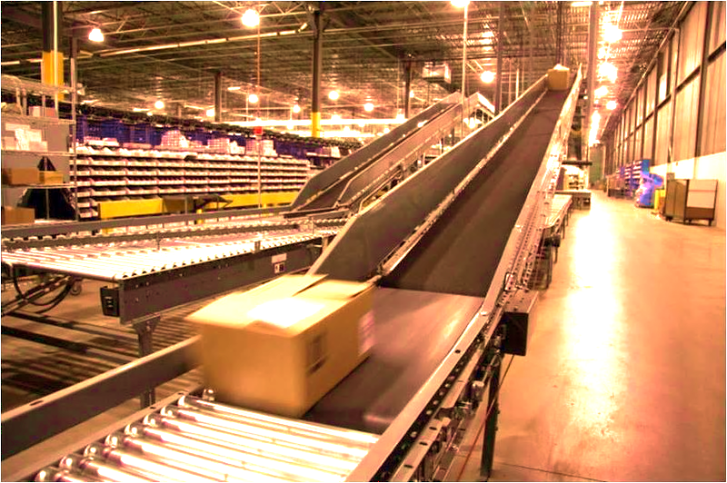


As you look at ways to add intelligence to your supply chain, consider these questions:
Which areas of your supply chain can benefit most from the infusion of new technology?
How responsive is your supply chain and decision making to the data and its perishability?
What should you do today to be ready for the future of
technology-enabled supply chains?

Slide 28
Watson Supply Chain is a pioneer in the cognitive supply chain space
Learning
Evidence-based
Analytics
Natural Language
Cognitive Technologies
Hypothesis Generation
Notes:
IBM is investing in cognitive for the supply chain with Watson Supply Chain
Cognitive systems can ingest all of this data and understand it. Cognitive systems can also serve up insights and recommendations based on this vast array of data in forms that are easy to understand and easy to interact with. And be always on, always advising and supporting the work you need to do when you need to do it.

Slide 29

Understand
How would your supply chain change if…
you had a ‘cognitive advisor’ giving you insights into your suppliers, categories, risks and more?
5/14/18
Notes:
Understand: How would your supply chain operations change if you had a cognitive advisor … giving you
insights into your suppliers, spend categories, risk factors and more – by accessing and evaluating both structured and unstructured data from countless internal and external sources?

Slide 30
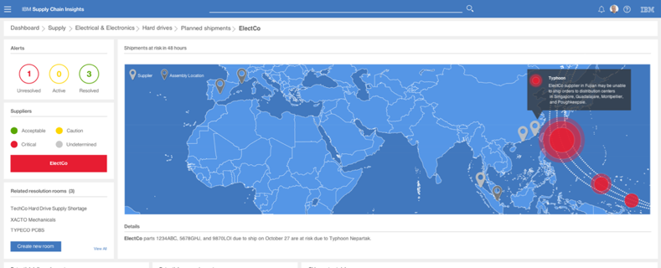
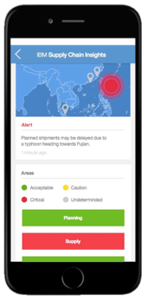
IBM Watson Supply Chain Insights
A view of aggregated KPIs, mobile alerts, analytics and social collaboration tools to solve business challenges
Notes:
Concept dashboard example:
Watson Supply Chain Insights will provide a singled trusted source of information, aggregated key process indicators (KPIs), mobile alerts, analytics and social collaboration tools to solve business challenges. This includes tracking every component part that needs to be available to keep the production line running. It monitors forecasts and bill of material changes, it pays special attention to critical parts and keeps an eye on all parts, and constantly reviews supply commits and inventory positions to ensure that right goods are in the right places at the right times while mitigating risk and optimizing delivery methods.

Slide 31

Reason
How would your supply chain change if…
your trading partner network automatically recognized document types and mapped them to supply chain flows – allowing you to track and be notified before you missed a Service Level Agreement?
Notes:
Reason: How would your supply chain operations change if …
your trading partner network automatically recognized document types and mapped them to supply chain flows – allowing you to track and be notified before you missed a Service Level Agreement?

Slide 32
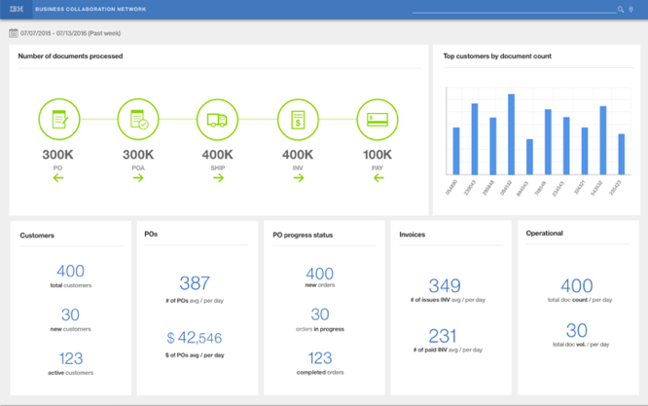
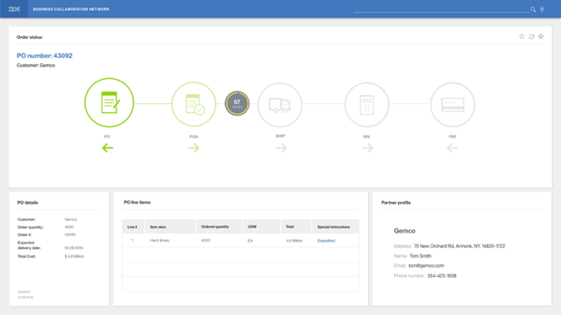
IBM Supply Chain Business Network
IBM Supply Chain Business Network delivers visibility and insight for your trading partner network with recommendations and alerts to optimize supply chain processes based on actual supplier/ partner performance.
Notes:
Concept Dashboard Example:
IBM Supply Chain Business Network – will correlate the transactional documents that flow between you and your trading partners and highlight where there are problems that could impact delivery. It can offer you a 360 degree understanding of your trading partner network, its performance and relationship to KPIs, with recommendations and alerts to optimize supply chain processes using real-time data from the entire chain of a transaction, prioritize projects based on actual supplier/partner performance, monitor and analyze service level agreements with trading partners.

Slide 33

Learn How would your supply chain change if… you had a ‘risk agent’ looking at news, weather and information on suppliers, categories and geographies that uncovers trends, patterns and relationships to help you proactively manage risk?

Slide 34
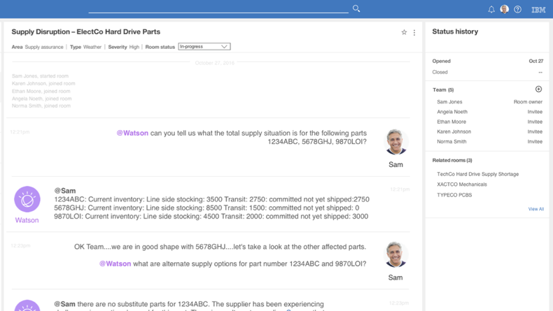
IBM Supply Risk Insights
IBM Supply Risk Insights helps assess and quantify risk information quickly and proactively using both internal and external sources of data.
Notes:
Concept Dashboard Example:
IBM Supply Risk insights helps monitor and assess risk information more broadly, quickly and proactively using both internal and external sources of information.
… you can instantly access and analyze structured and unstructured content from across data sources and the Internet. The solution prioritizes news, social media feeds and information on relevant suppliers, categories and geographies – and then presents data, analytics and cognitive insights in a single view. The solution gives you the information you’re looking for while uncovering trends, patterns and relationships beyond the capacity of humans or other systems.
… you can quantify and model that risk in a way that lets you prioritize and take action.

Slide 35

Interact How would your supply chain change if… you had a way to discuss options and solve problems with those inside and outside your company, in real-time, as they arose?
Notes:
Interact:
How would your supply chain change if…
you had a way to discuss options and solve problems with those inside and outside your company, in real-time, as they arose? Or better to anticipate and correct them before they are a disruption. And those conversations were documented and absorbed into the system in real time to help solve future problems

Slide 36
IBM Supply Chain Insights
Cognitive resolution rooms enable you to interact with stake-holders, institutional knowledge and apply cognitive insights to resolve disruptions
Notes:
The Cognitive Resolution Rooms are a venue for colleagues to asynchronously or synchronously solve problems utilizing social tools like group chat, SMS text, and phone to text transcription. It has features like problem description and classification, and tracking of the problem through its lifecycle stages and archiving of the problem when it is closed. It acts as an enterprise knowledge management tool.

Slide 37

IBM & SAP are collaborating on Digital Transformation enabling the incumbents to strike back
This partnership supports IBM’s data, cognitive, and blockchain solutions with the SAP Digital Transformation Framework
Notes:
SAP Digital Transformation Framework methodology helps customers create an end-to-end digital enterprise architecture that:
Allows core transactions and analytics to run consistently and uninterrupted
Connects seamlessly with solutions that support workforce engagement, supplier collaboration, the customer experience, and assets within the company and supply chain
The combination of IBM cognitive computing and SAP technology provides high-tech companies with a huge opportunity to reimagine how their business operates and develop an agile organization and IT environment that can adapt to changing business conditions. Here are just some of the applications that are available.
Visual Inspection for SAP Software - harness cognitive capabilities to identify defects in parts, components, and products by matching patterns to images of defects that were previously analyzed and classified. The solution interfaces with back-end SAP software to handle the quality issues and initiate maintenance work orders.
Distributed Manufacturing - capitalize on direct manufacturing to meet changing customer demands, streamline supply chains, and speed time to market. The SAP Distributed Manufacturing application helps you achieve these goals by connecting supply chain solutions from SAP with the 3D printing capabilities of a global manufacturing and logistics partner network.
Cognitive Maintenance Management - access data from connected equipment and products and analyze it in conjunction with existing service knowledge and other sources of relevant external data. Tap the data to understand how to improve equipment quality, uptime, service time, and the overall service experience.
IoT for Uptime - Analyze sensor data throughout a plant and use trade-o analytics to determine the best course of action.
Smart Materials Planning - leverage machine learning algorithms to correct errors in master data before they have an impact on the bottom line.

Slide 38
Digital Transformation from IBM + SAP can leverage all of an enterprise’s data and surround it with smart technologies
Technologies to
leverage data
Machine
learning
Cognitive
& AI
Data sources
AR/VR
Video &
spatial
Analytics
ERP
Social
Robotics &
Autonomous vehicles
IoT
Cloud
Digital Scanning
Blockchain
Cognitive
Client
experiences
Data science
& Algorithms
Orchestrated
ERP
Symbiotic
Natural
Language
Processing
Visualization
Additive
manufacturing
Contextual
Cellular &
Satellite
Comms
Blockchain
OT Security IT Security

